Slide 1
SOFTWARE ENGINEERING (15B11CI513 ) Credits :- 4 Contact Hours :- 3-1-0

Slide 2
Agile methods
Dissatisfaction with the overheads involved in software
design methods of the 1980s and 1990s led to the creation of agile methods. These methods:
Focus on the code rather than the design
Are based on an iterative approach to software development
Are intended to deliver working software quickly and evolve this quickly to meet changing requirements.
The aim of agile methods is to reduce overheads in the
software process (e.g. by limiting documentation) and to be able to respond quickly to changing requirements without excessive rework.
2

Slide 3
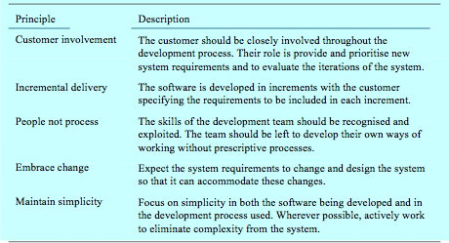
Principles of agile methods

Slide 4
Agile Methods
Comparison with traditional methods
Agile methods require customer involvement throughout development versus involvement only at specific phases.
Agile methods only develop detailed plans for the near term versus detailed planning over the entire project.
Agile methods use working code and prototypes versus documentation
Agile methods rely on early developer test case development versus separate test functions.
Example Test Driven Development
Agile methods design for one feature at a time versus complete design.
Agile methods produce many small release versus a limited number of larger releases.

Slide 5
Agile method applicability
Product development where a software company is developing a small or medium-sized product for sale.
Custom system development within an organization, where there is a clear commitment from the customer to become involved in the development process, and where there are not many external rules and regulations that affect the software.
Because of their focus on small, tightly-integrated teams, there are problems in scaling agile methods to large systems.
7

Slide 6
Problems with agile methods
It can be difficult to keep the interest of customers who are involved in the process.
Team members may be unsuited to the intense involvement that characterizes agile methods.
Prioritizing changes can be difficult where multiple stakeholders are involved.
Maintaining simplicity requires extra work.
8

Slide 7
Agile Methods
Example Agile Methods
Extreme Programming OpenUP
LEAN Development Crystal
SCRUM
Test Driven Development
14

Slide 8
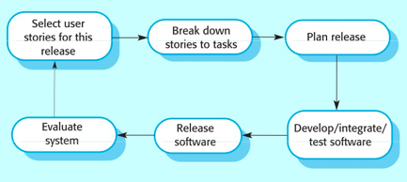
Extreme Programming
Perhaps the best-known and most widely used agile method.
Introduced by Kent Beck in 1999
The XP release cycle

Slide 9
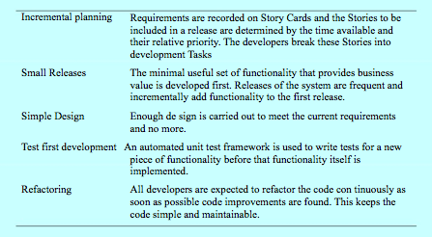
Extreme programming practices 1

Slide 10
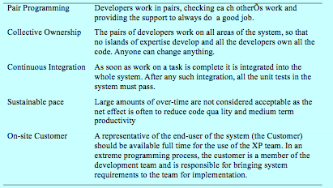
Extreme programming practices 2

Slide 11
XP and agile principles
Incremental development is supported through small, frequent system releases.
Customer involvement means full-time customer engagement with the team.
People not process through pair programming, collective ownership and a process that avoids long working hours.
Change supported through regular system releases.
Maintaining simplicity through constant refactoring of code.
19

Slide 12
Customer involvement
Customer involvement is a key part of XP where the customer is part of the development team.
The role of the customer is:
To help develop stories that define the requirements
To help prioritise the features to be implemented in each release
To help develop acceptance tests which assess whether or not the system meets its requirements.
20

Slide 13
Requirements scenarios
In XP, user requirements are expressed as scenarios or user stories.
These are written on cards and the development team break
them down into implementation tasks. These tasks are the basis of schedule and cost estimates.
The customer chooses the stories for inclusion in the next release based on their priorities and the schedule estimates.
21

Slide 14
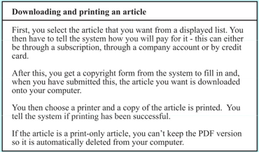
Story card for document downloading

Slide 15
XP and change
Conventional wisdom in software engineering is to design for change. It is worth spending time and effort anticipating changes as this reduces costs later in the life cycle.
XP, however, maintains that this is not worthwhile as changes cannot be reliably anticipated.
Rather, it proposes constant code improvement (refactoring) to make changes easier when they have to be implemented.
23

Slide 16
Refactoring
Refactoring is the process of code improvement where code is reorganised and rewritten to make it more efficient, easier to understand, etc.
Refactoring is required because frequent releases mean that
is developed incrementally and therefore tends to become messy.
Refactoring should not change the functionality of the system.

Slide 17
Testing in XP
Test-first development.
Incremental test development from scenarios.
User involvement in test development and validation.
Automated test harnesses are used to run all component tests each time that a new release is built.

Slide 18
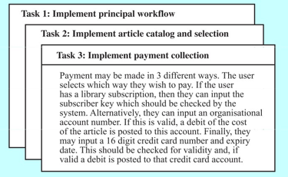
Task cards for document downloading

Slide 19
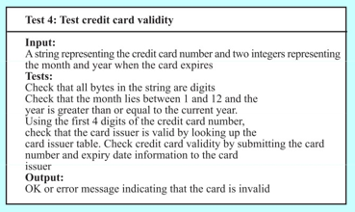
Test case description

Slide 20
Test-first development
Writing tests before code clarifies the requirements to be implemented.
Tests are written as programs rather than data so that they can be executed automatically. The test includes a check that it has executed correctly.
All previous and new tests are automatically run when new functionality is added. Thus checking that the new functionality has not introduced errors.

Slide 21
Pair programming
In XP, programmers work in pairs, sitting together to develop code.
This helps develop common ownership of code and spreads knowledge across the team.
It serves as an informal review process as each line of code is looked at by more than 1 person.
It encourages refactoring as the whole team can benefit from this.
Measurements suggest that development productivity with pair programming is similar to that of two people working independently.

Slide 22
Problems with XP
Customer involvement
This is perhaps the most difficult problem. It may be difficult or impossible to find a customer who can represent all stakeholders and who can be taken off their normal work to become part of the XP team. For generic products, there is no ‘customer’ - the marketing team may not be a typical of real customers.
Architectural design
The incremental style of development can mean that inappropriate architectural decisions are made at an early stage of the process.
Problems with these may not become clear until many features have been implemented and refactoring the architecture is very expensive.

Slide 23
Problems with XP cont…
Test complacency
It is easy for a team to believe that because it has many tests, the system is properly tested.
Because of the automated testing approach, there is a tendency to develop tests that are easy to automate rather than tests that are ‘good’ tests.

Slide 24
Key points
Extreme programming includes practices such as systematic testing, continuous improvement and customer involvement.
Customers are involved in developing requirements which are expressed as simple scenarios.
The approach to testing in XP is a particular strength where executable tests are developed before the code is written.
Key problems with XP include difficulties of getting representative customers and problems of architectural design.

Slide 25
Scrum
• Scrum is an agile process that allows us to focus on delivering the highest business value in the shortest time.
• It allows us to rapidly and repeatedly inspect actual working software (every two weeks to one month).
• The business sets the priorities. Teams self-organize to determine the best way to deliver the highest priority features.
• Every two weeks to a month anyone can see real working
software and decide to release it as is or continue to enhance it for another sprint.

Slide 26
Characteristics
Self-organizing teams
Product progresses in a series of month-long “sprints”
Requirements are captured as items in a list of “product backlog”
No specific engineering practices prescribed
Uses generative rules to create an agile environment for delivering projects
One of the “agile processes”

Slide 27
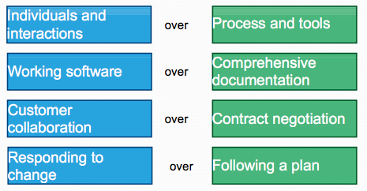
The Agile Manifesto-a statement of values

Slide 28
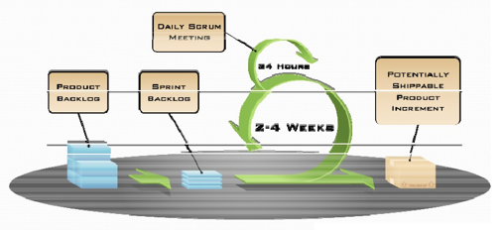
SCRUM

Slide 29
Sprints
Scrum projects make progress in a series of “sprints”
Analogous to Extreme Programming iterations
Typical duration is 2-4 weeks or a calendar month at most
A constant duration leads to a better rhythm
Product is designed, coded, and tested during the sprint

Slide 30
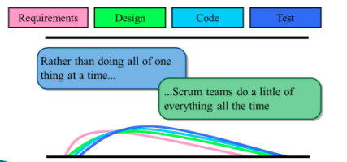
Sequential vs. overlapping development
Source: “The New New Product Development Game” by Takeuchi and Nonaka. Harvard Business Review, January 1986.

Slide 31
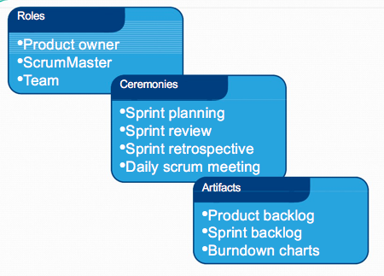
Scrum framework

Slide 32
Roles: Product owner
Define the features of the product
Decide on release date and content
Be responsible for the profitability of the product (ROI)
Prioritize features according to market value
Adjust features and priority every iteration, as needed
Accept or reject work results

Slide 33
Roles: The Scrum Master
Represents management to the project
Responsible for enacting Scrum values and practices
Removes impediments(obstruction)
Ensure that the team is fully functional and productive
Shield the team from external interferences

Slide 34
Roles: The team
Typically consists of 5-9 people
Cross-functional:
Programmers, testers, user experience designers, etc.
Teams are self-organizing

Slide 35
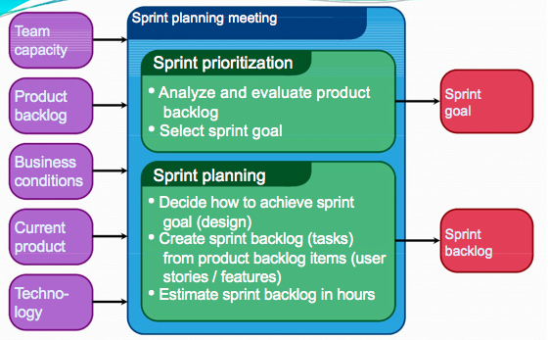
Ceremonies: Sprint planning

Slide 36
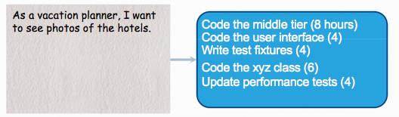
Ceremonies: Sprint planning
Team selects items from the product backlog they can commit to completing
Sprint backlog is created
Tasks are identified and each is estimated
Collaboratively, not done alone by the Scrum Master
High-level design is considered

Slide 37
Ceremonies: The daily scrum
Parameters
Daily
15-minutes
Stand-up
Not for problem solving
Only team members, Scrum Master, product owner, can talk
Helps avoid other unnecessary meetings

Slide 38
Ceremonies: The sprint review
Team presents what it accomplished during the sprint
Typically takes the form of a demo of new features or underlying architecture
Informal
2-hour prep time rule
No slides
Whole team participates

Slide 39
Ceremonies: Sprint retrospective
Periodically take a look at what is and is not working
Typically 15-30 minutes
Done after every sprint
Whole team participates
Scrum Master
Product owner
Team
Possibly customers and others

Slide 40
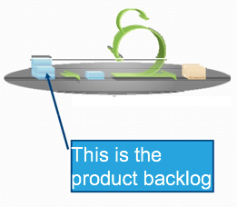
Artifacts: Product backlog
The requirements
A list of all desired work on the project
Ideally expressed such that each item has value to the users or customers of the product
Prioritized by the product owner
Reprioritized at the start of each sprint

Slide 41
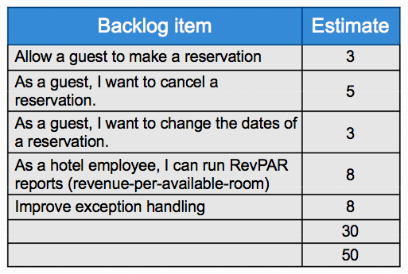
A sample product backlog

Slide 42
Cons
The basic premise that the team is committed to the project. If the team is not committed then process collapses
The management's comfort level in delegation of tasks
The size of the team is restricted due to the involvement of all team members
Suited for development of new products and not for enhancement of an existing product
Reliance on experience

